Slide 1
Citi Bike Data Analysis
By
Susanna A. Blankson

Slide 2
Project Goal:
To better understand the behavior of Citi Bike’s customer base (both one-time users and subscribers) and how they use Citi Bikes
This will help us to:
Identify where more bikes should be installed
Create targeted marketing campaigns that will appeal to different customer segments

Slide 3
Key questions:
What are the most popular pick-up locations across the city for Citi Bike rental?
How does the average trip duration vary across different age groups?
Which age group rents the most bikes?
How does bike rental vary across the two user groups (one-time users vs long-term subscribers) on different days of the week?
Does the factor of user age impact the average bike trip duration?

Slide 4
Findings & Insights

Slide 5
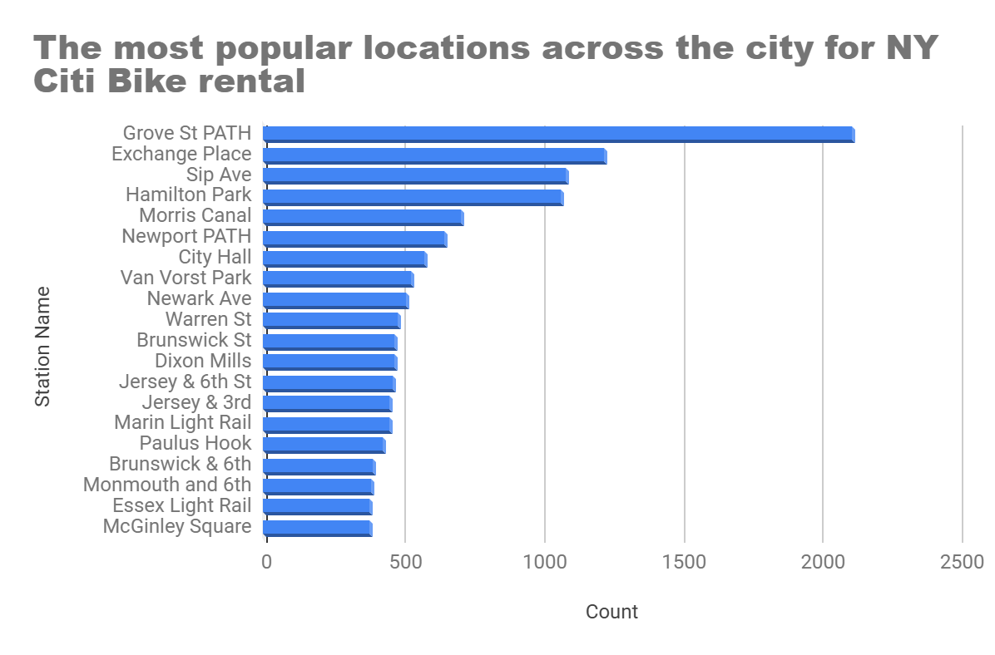
What are the most popular Citi Bike pick-up locations?

Slide 6
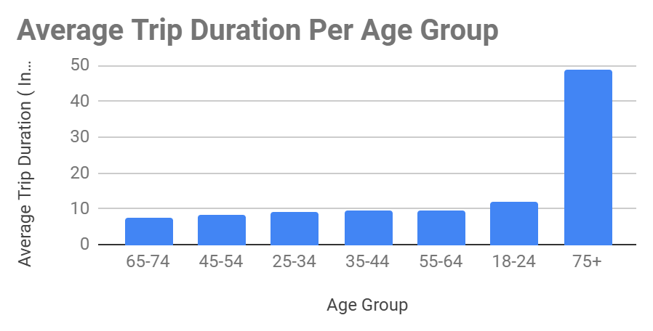
2. How does the average trip duration vary across different age groups?
Per findings based on averages
75+ year Olds take the longest trips ‘
65-74 year olds take the shortest trips

Slide 7
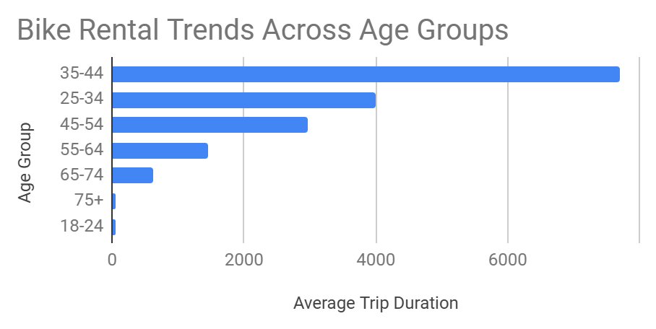
3. Which age group rents the most bikes?
Age group 35- 44 years have the highest bike rental
Whiles
18-24 year olds have the lowest.

Slide 8
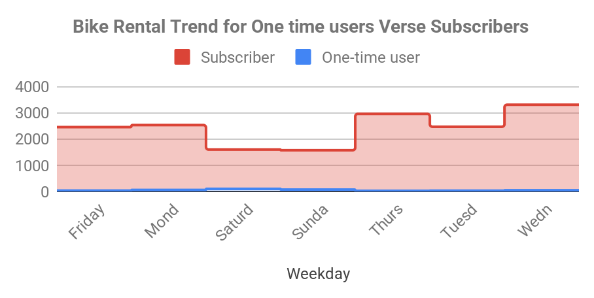
4. How does bike rental vary across the two user groups (one-time users vs long-term subscribers) on different days of the week?
Citi bike’s operations is based predominantly on subscription
Subscribers are more active during the week
whiles
one - time users are more active on weekends

Slide 9
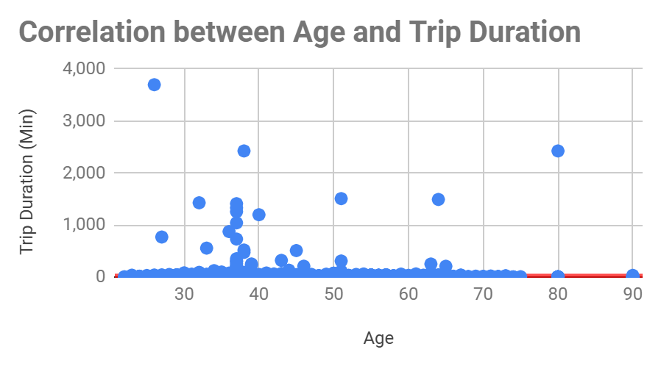
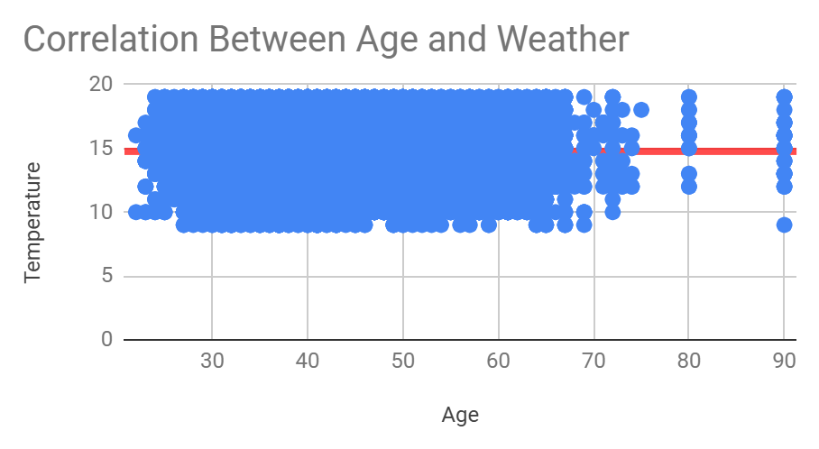
5. Do factors like weather and age impact the average bike trip duration?
No relationship between age and weather as indicated by the scatter plot and trend line
No relationship between age and trip duration

Slide 10
Summary

Slide 11
Summary of findings:
Top 5 pick-up locations for bikes:
Grove St Path, Exchange Place, Sip Ave, Hamilton Park, & Morris Canal
Customer base:
Citi Bikes client based is predominantly based on subscription with the highest rental from the 35-44 year age group
Citi Bike customer behavior:
Though the height rental for bike comes from 35-44 year group the 75+ year group has the longest trip time with 65-74 have the shortest

Slide 12
Actions & Recommendations

Slide 13
Recommended actions:
Product recommendations:
Based on the findings , more bikes should be install at Grove St Path, Exchange Place, Sip Ave, Hamilton Park, & Morris Cana to expand operational efficiency.
Marketing recommendations:
The Citi Bike customer base is mostly long-term subscribers aged between 35-44, who are most active during the week. This tells us that they are probably people who live in New York and use NY Citi Bikes to commute. Marketing and advertising campaigns should therefore target this particular demographic.

Slide 14
Thank you!

